Slide 1
Passenger and Freight Railroad Employee Data
Theodora Cheng
Andrea Curo
Sonam Shah

Slide 2
The Data - Description
Survey of freight and railroad employees
Background of Employees
Alertness and Sleep Ratings of Employees
Activity Data

Slide 3
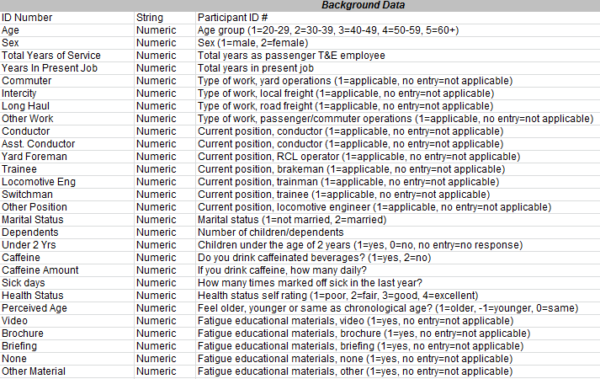
Table 1 Background Data
ID Number

Slide 4
Table 1 Background Data
Age

Slide 5
Table 1 Background Data
Sex

Slide 6
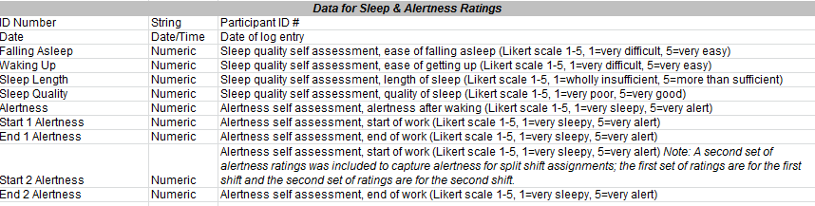
Table 2 Data for Sleep & Alertness Ratings
ID

Slide 7
Table 2 Data for Sleep & Alertness Ratings
Sleep Quality

Slide 8
Table 2 Data for Sleep & Alertness Ratings
Alertness

Slide 9
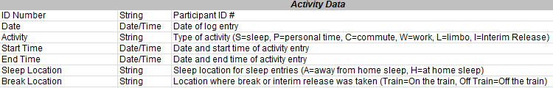
Table 3 Activity Data
ID

Slide 10
Table 3 Activity Data
Sleep Location

Slide 11
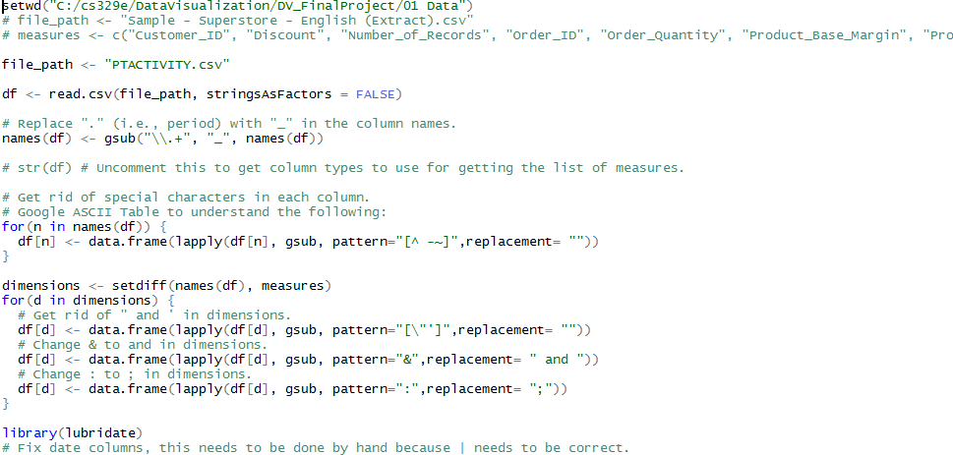
The Data - Processing
Separate
Reformat

Slide 12
Tableau Getting Data from Oracle

Slide 13
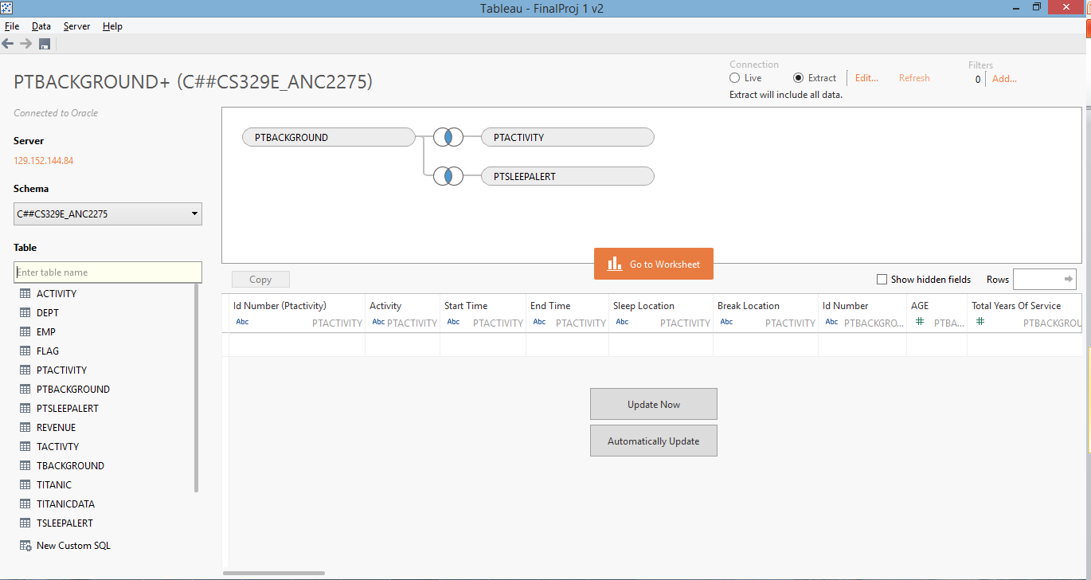
Data Source
Pulled data from Oracle and linked each table by ID number of employees

Slide 14
Data Blending

Slide 15
Visualization 1
Sleep Quality
Quality of sleep
(1-5, 1=very poor, 5=very good)
Sleep Location
Sleep location for sleep entries
(A=away from home sleep, H=at home sleep)
Sleep Length
Length of Sleep
(1-5, 1=wholly insufficient, 5=more than sufficient)

Slide 16
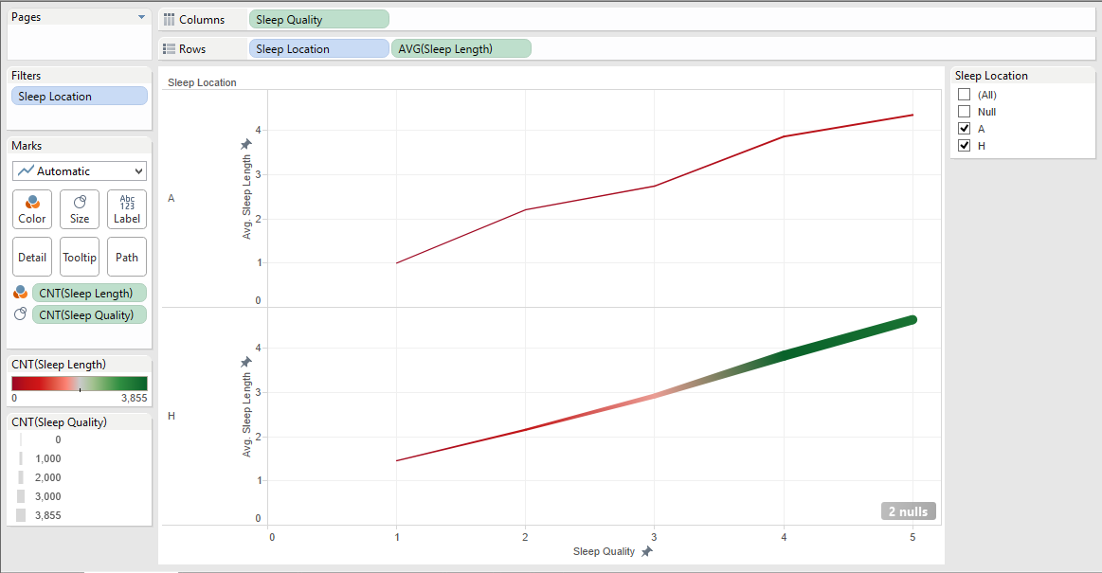
Visualization 1
Columns - Sleep Quality

Slide 17
Visualization 1
Rows – Sleep Location, AVG(Sleep Length)

Slide 18
Visualization 1
Filtered out NULL sleep locations

Slide 19
Visualization 1
COLOR – how many employees at each sleep length

Slide 20
Visualization 1
SIZE – how many employees at each sleep quality

Slide 21
Visualization 1
*Color (greener) – More employees sleep at home at sleep length 3-5

Slide 22
Visualization 1
*Size (thicker) – More employees sleep at home at sleep quality 3-5

Slide 23
Visualization 1
*In this sample size, more employees tend to sleep at a higher quality (3-5) with a higher sleep length (3-5) at home

Slide 24
Visualization 1
*At sleep quality 1, sleep length averages at 1 away from home

Slide 25
Visualization 1
*At sleep quality 1, sleep length averages at 1.45 at home

Slide 26
Visualization 1
*On average, at sleep quality 1, employees need 0.45 more sleep at home

Slide 27
Visualization 1
*At sleep quality 5, sleep length averages at 4.3 away from home

Slide 28
Visualization 1
*At sleep quality 5, sleep length averages at 4.6 at home

Slide 29
Visualization 1
*On average, at sleep quality 5, employees need 0.3 more sleep at home

Slide 30
Visualization 1
*Although slight differences in sleep length at the low and high of each sleep quality, there appears to be a near 1 to 1 relation between sleep quality and sleep length regardless of sleep location

Slide 31
Visualization 2
Caffeine Amount
If drink caffeine, how many daily
Start Alertness
Alertness at start of work
(1-5, 1=very sleepy, 5=very alert)
End Alertness
Alertness at end of work
(1-5, 1=very sleepy, 5=very alert)

Slide 32
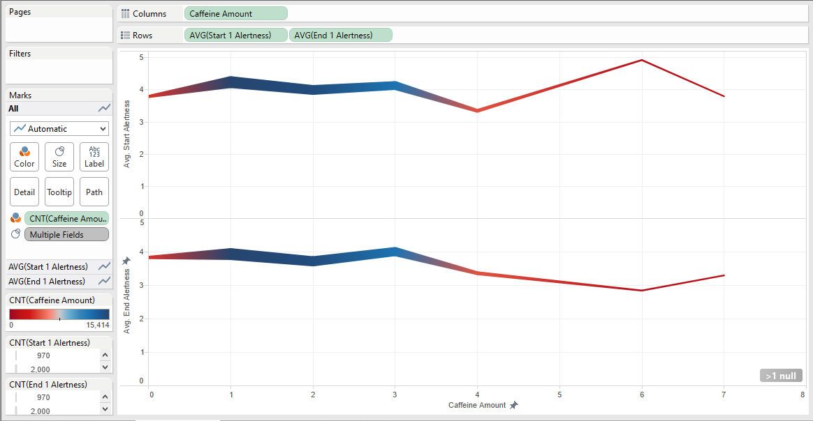
Visualization 2
Columns – Caffeine Amount

Slide 33
Visualization 2
Rows – AVG(Start Alertness), AVG(End Alertness)

Slide 34
Visualization 2
COLOR – how many employees at each caffeine amount

Slide 35
Visualization 2
SIZE – how many employees at each start/end alertness

Slide 36
Visualization 2
*Color (bluer) – More employees drink 1-3 cups of coffee

Slide 37
Visualization 2
*Size (thicker) – More employees have alertness around 4

Slide 38
Visualization 2
*From caffeine amount 1-3, average alertness is 4

Slide 39
Visualization 2
*After 3 cups of coffee, the average start alertness drops down to 3.35 and average end alertness drops down to 3.36

Slide 40
Visualization 2
*At 6 cups of coffee, the average start alertness spikes to 4.9

Slide 41
Visualization 2
*And at 6 cups of coffee, the average end alertness drops to 2.8

Slide 42
Visualization 2
*Caffeine amount 6 has 2.1 average difference in start and end alertness – the largest drop from start to end alertness

Slide 43
Visualization 2
*1-3 cups of caffeine shows the highest average start/end alertness with the smallest drop in start to end alertness

Slide 44
Visualization 3
Years in Present Job
Total years in present job
Work Schedule
Stress due to lack of control over work schedule
(1=no stress, 2=a little stress, 3=frequently, 4=always)
Job Security
Stress due to job security
(1=no stress, 2=a little stress, 3=frequently, 4=always)
Staffing
Stress due to inadequate staffing
(1=no stress, 2=a little stress, 3=frequently, 4=always)

Slide 45
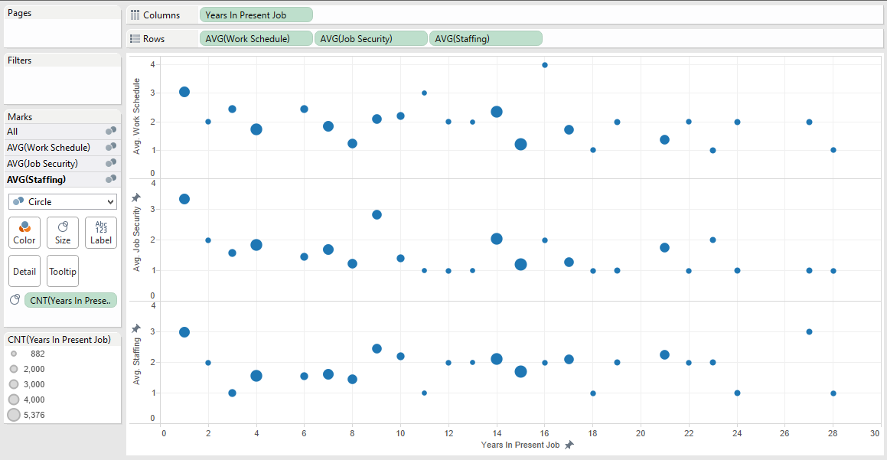
Visualization 3
Columns – Years in Present Job

Slide 46
Visualization 3
Rows – Avg(Work Schedule) Avg(Job Security), Avg(Staffing)

Slide 47
Visualization 3
Size – how many employees per years worked in present job

Slide 48
Visualization 3
*After 16 years in present job, work schedule stress drops to 2 or below

Slide 49
Visualization 3
*After 9 years in present job, job security stress drops to 2 or below

Slide 50
Visualization 3
*After 1 year in present job, inadequate staffing stress drops to 2.5 or below and spikes back up in year 27

Slide 51
Visualization 3
*The overall stress levels drop after year 16, with number of employees decreasing as well

Slide 52
Visualization 4
Age
Age group
(1=20-29,2=30-39, 3=40-49, 4=50-59, 5=60+)
Weekly Work Hours
Average number of hours per week

Slide 53
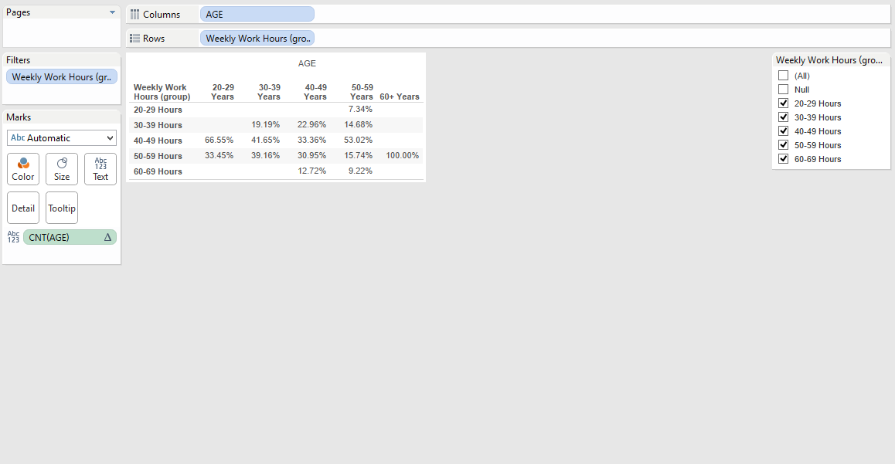
Visualization 4
Columns – Age

Slide 54
Visualization 4
Rows – Weekly Work Hours

Slide 55
Visualization 4
Grouped the work hours into ranges in increments of 10

Slide 56
Visualization 4
Took out the null values from weekly work hours

Slide 57
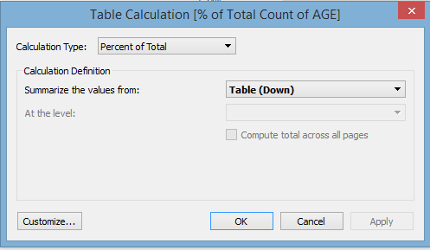
Visualization 4
Calculated percentages of how many hours worked every week by age group

Slide 58
Visualization 4
*The majority of employees in their 20’s and 50’s average worked 40-49 hours a week

Slide 59
Visualization 4
*The majority of employees in their 30-40’s average worked 40-59 hours a week

Slide 60
Visualization 4
*The majority of employees in their 60+’s average worked 50-59 hours a week

Slide 61
Visualization 4
*The majority of employees overall worked on average 40-59 hours a week

Slide 62
Additional Tableau Visualizations

Slide 63
Measure vs. Sleep Quality
Sleep Quality
Quality of sleep
(1-5, 1=very poor, 5=very good)
Falling Asleep
Ease of falling asleep
(1-5, 1=very difficult, 5=very easy)
Health Status
Self assessment of health status
(1-4, 1=poor, 4=excellent)

Slide 64
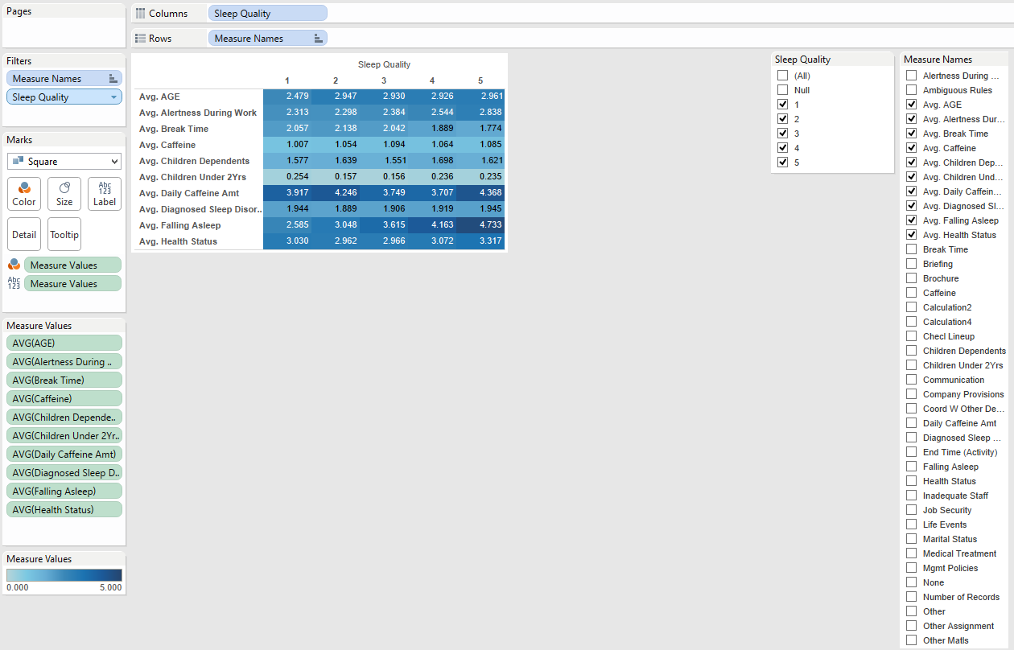
Measure vs Sleep Quality

Slide 65
Measure vs Sleep Quality

Slide 66
Measure vs Sleep Quality

Slide 67
Measure vs Sleep Quality

Slide 68
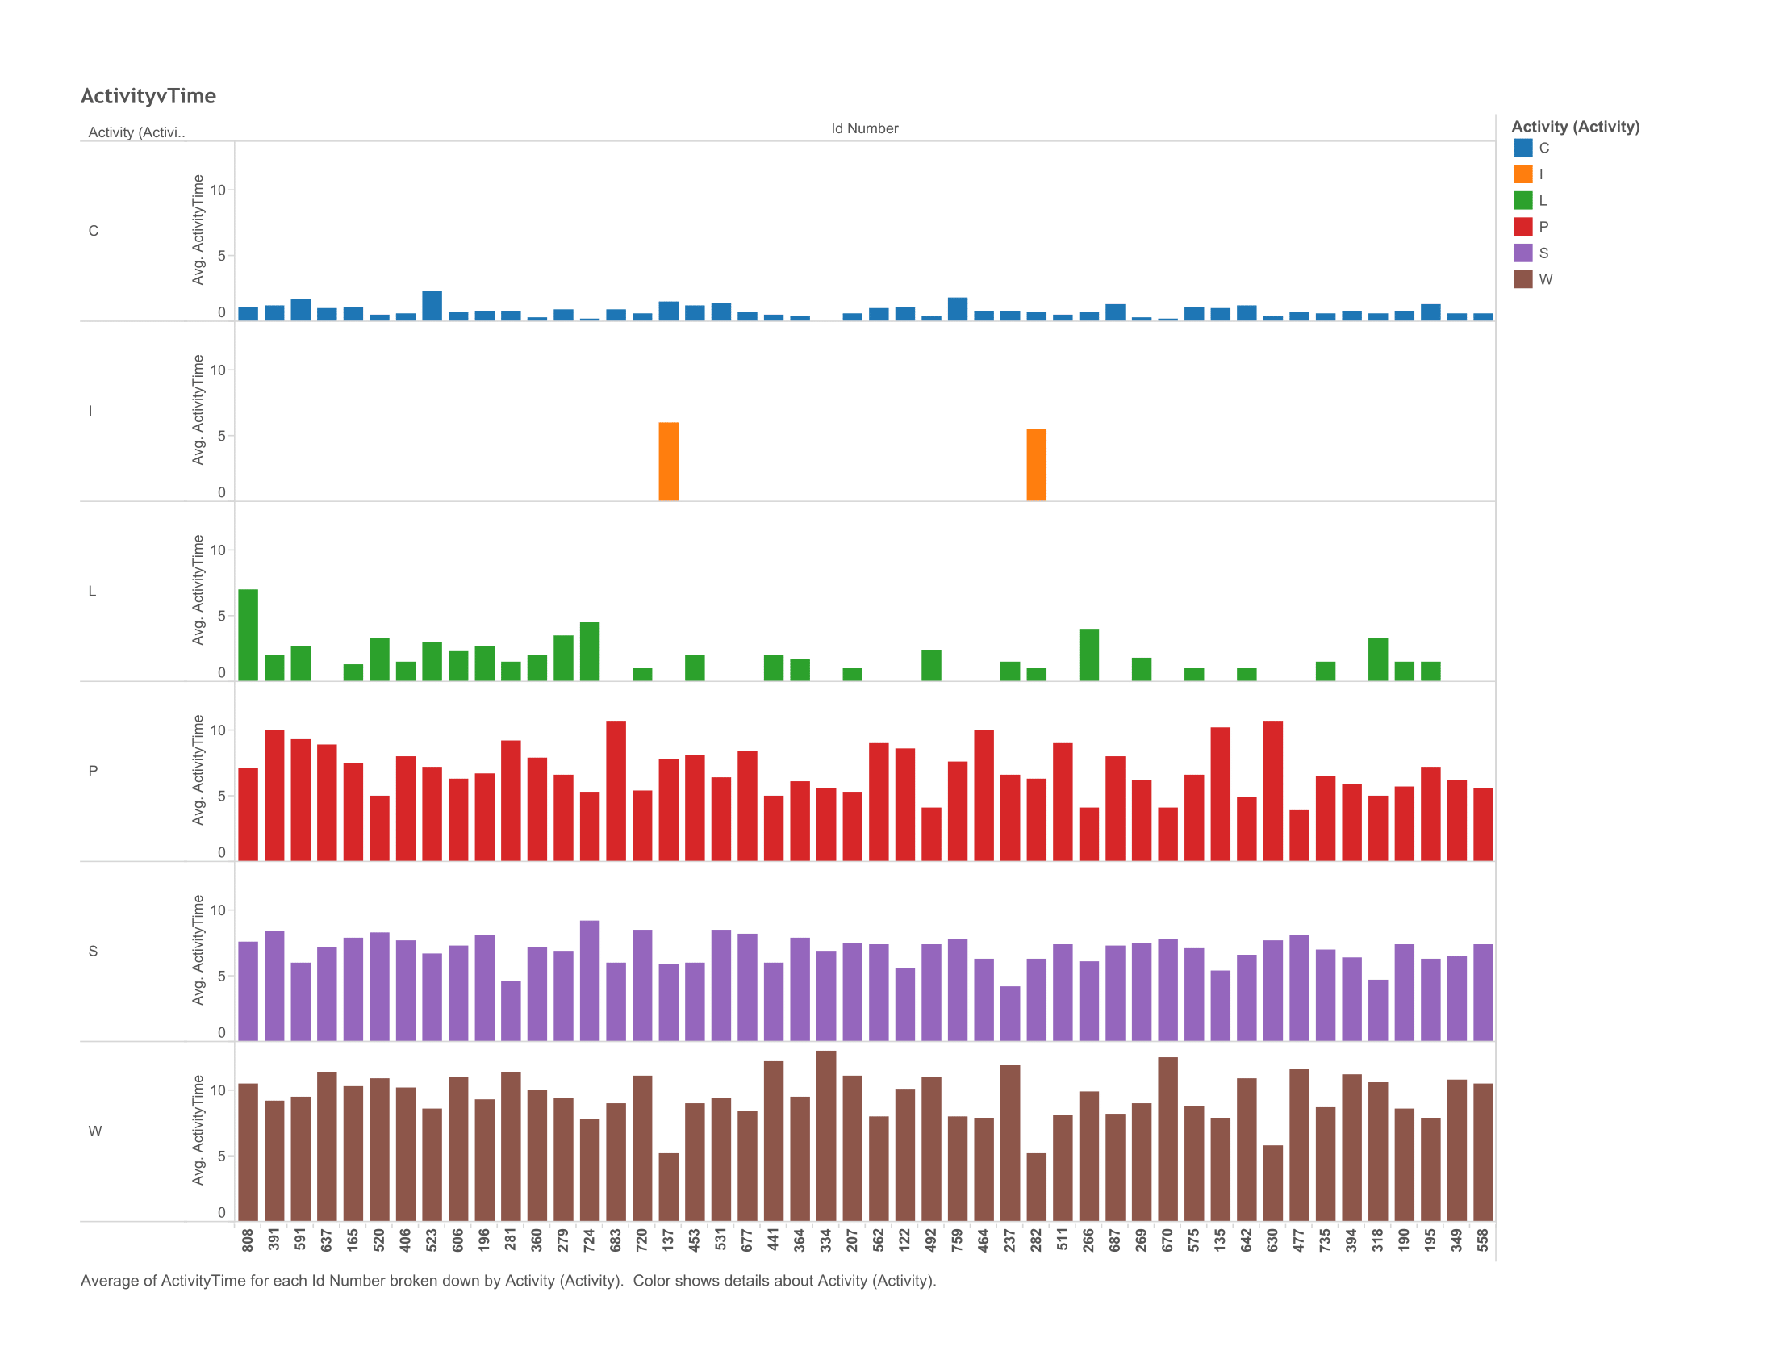
Time per Activity Type

Slide 69
Time per Activity Type
ID Number
Participant ID Number
Activity
Type of Activity
(S=Sleep, P=Personal, C=Commute, W=Work, L=Limbo, I=Interim Release)

Slide 70
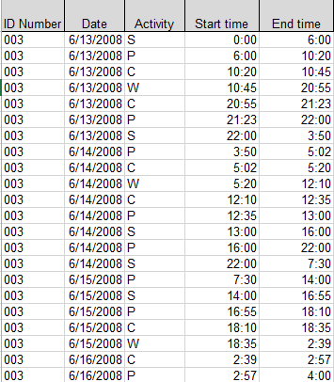
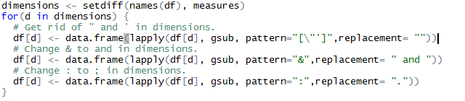
Time per Activity Type
Reformatting the Data

Slide 71
Time per Activity Type
Created calculated field
IF [Start Time (Activity)]>[End Time (Activity)]
THEN 24 - [Start Time (Activity)] + [End Time (Activity)]
ELSE [End Time (Activity)] - [Start Time (Activity)] END

Slide 72
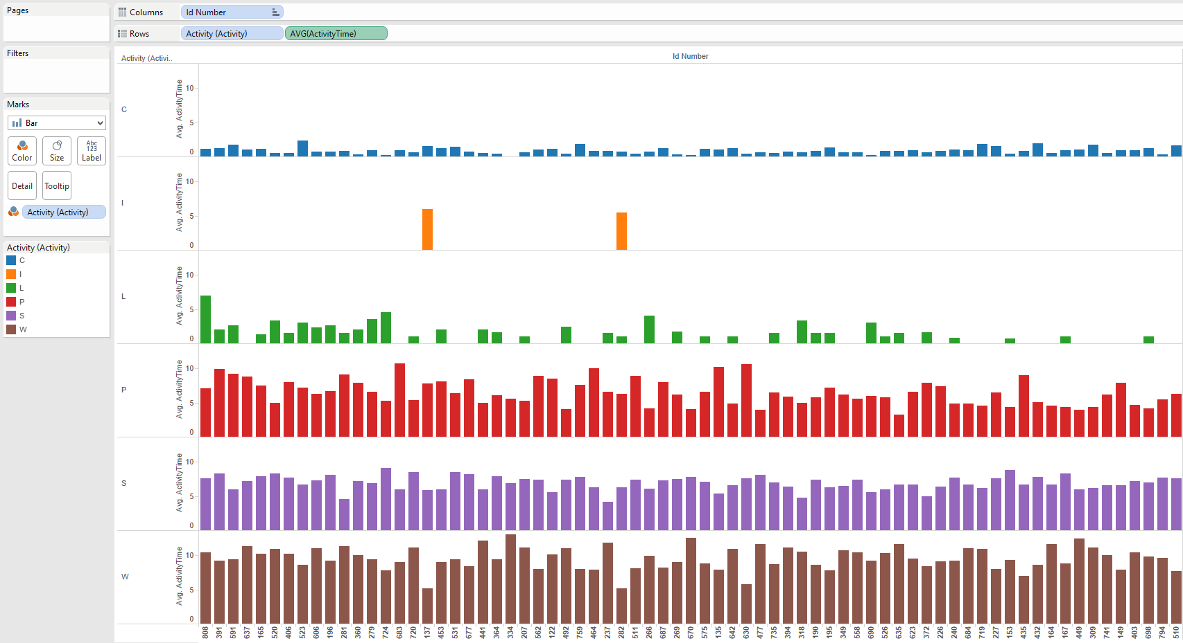
Time per Activity Type

Slide 73
Time per Activity Type

Slide 74
Time per Activity Type

Slide 75
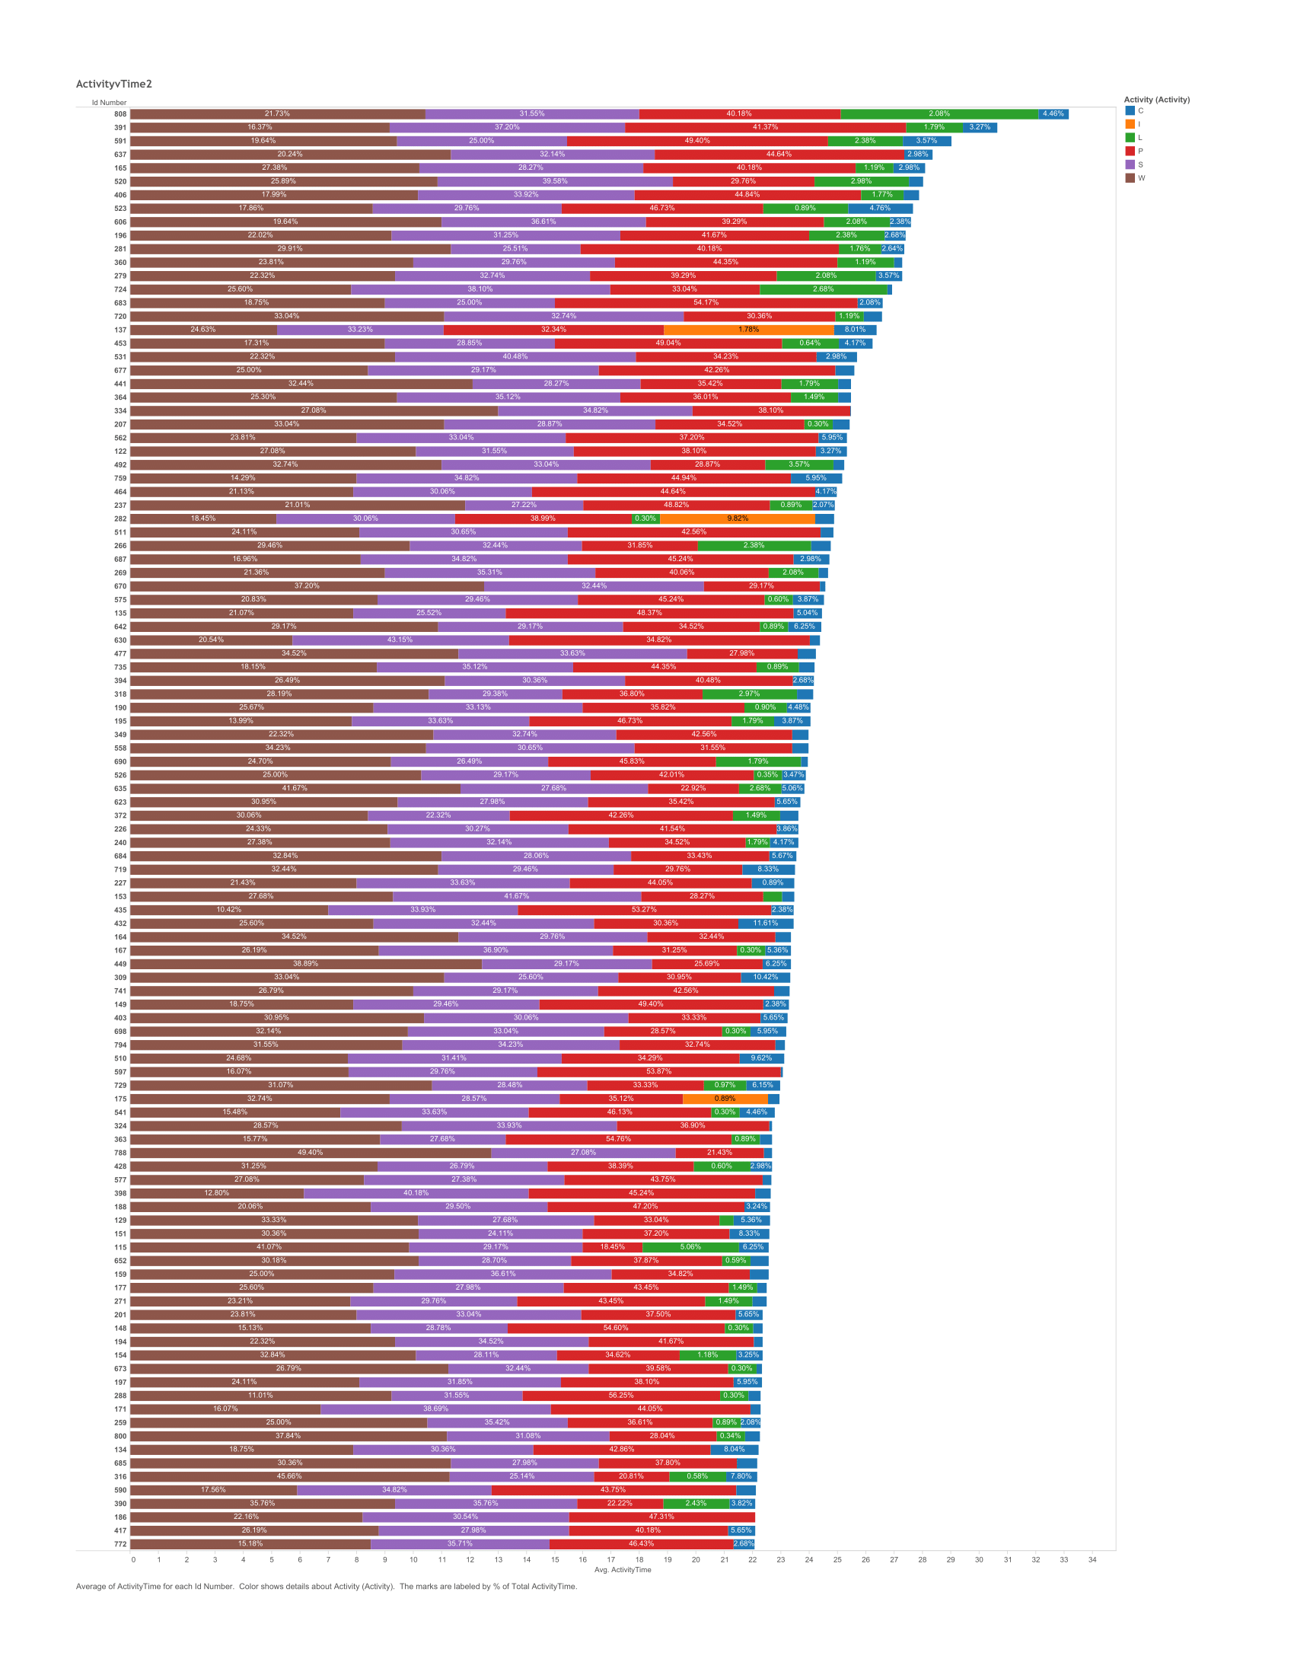
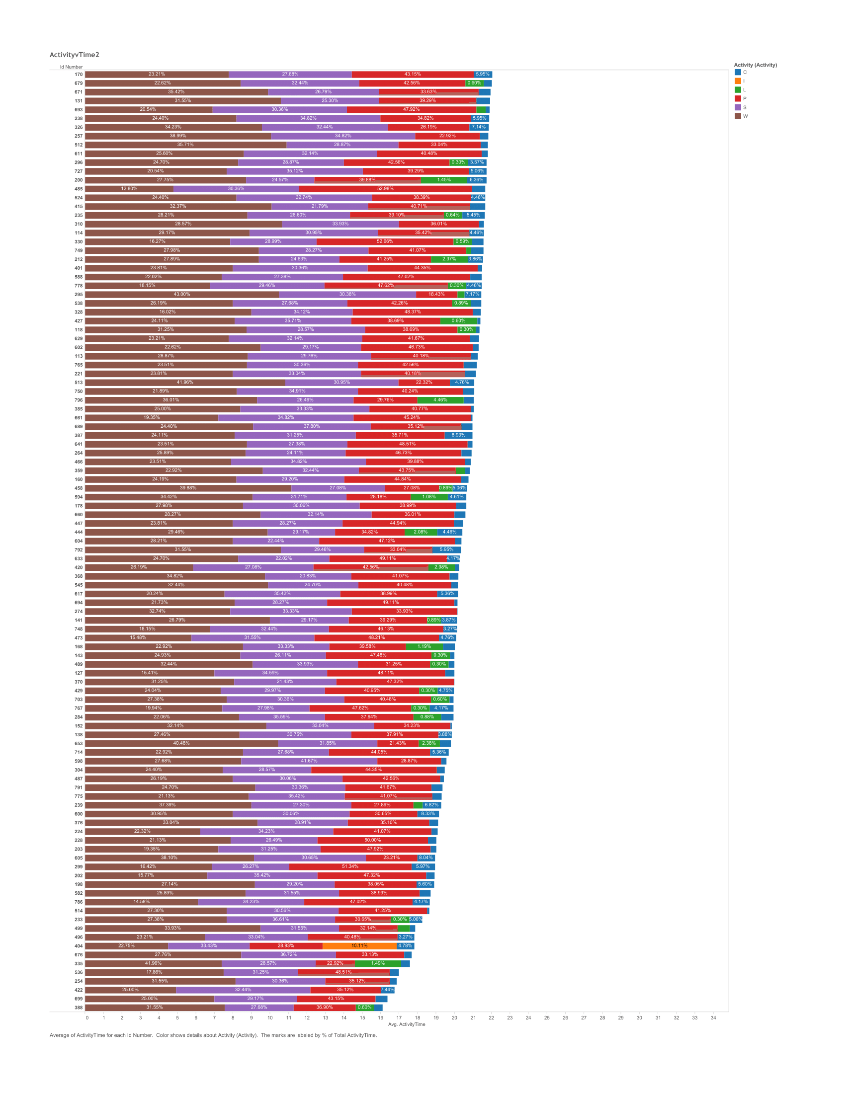
Time per Activity Type v2

Slide 76
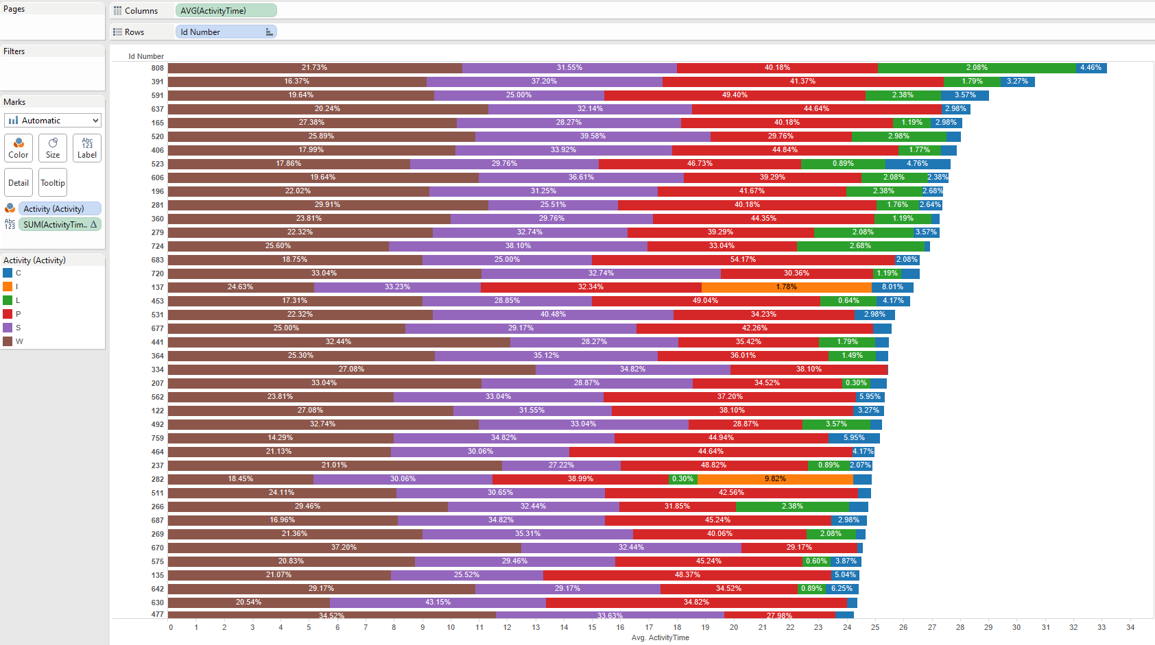
Time per Activity Type v2

Slide 77
Time per Activity Type v2

Slide 78
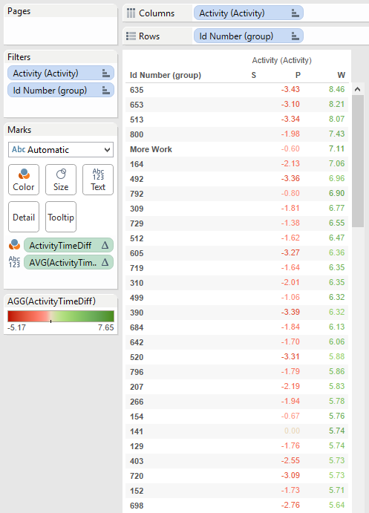
Creating Groups
Filtered by most time consuming activities
Calculated difference from activity S (sleep)
ZN(AVG([ActivityTime (copy)])) - LOOKUP(ZN(AVG([ActivityTime (copy)])), -1)

Slide 79
Group Analysis
ID Number
Participant ID number
Falling Asleep
Ease of falling asleep
(1-5, 1=very difficult, 5=very easy)
Sleep Quality
Quality of sleep
(1-5, 1=very poor, 5=very good)

Slide 80
Group Analysis
Sleep Length
Length of sleep
(1-5, 1=wholly insufficient, 5=more than sufficient
Sleep Loss
Stress due to loss of sleep
(1=no stress, 2=a little stress, 3=frequently, 4=always)
Caffeine Amount
If drink caffeine, how many daily

Slide 81
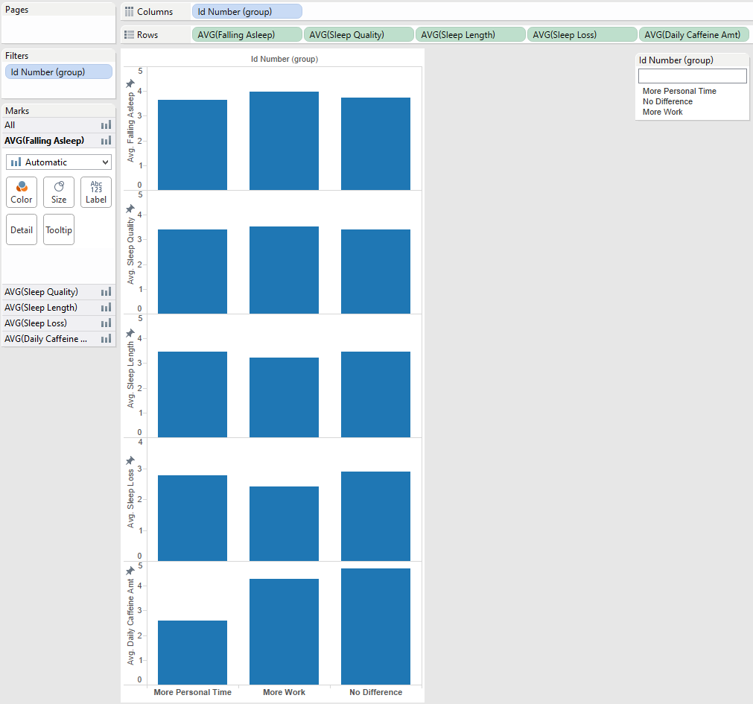
Group Analysis

Slide 82
Group Analysis

Slide 83
Group Analysis

Slide 84
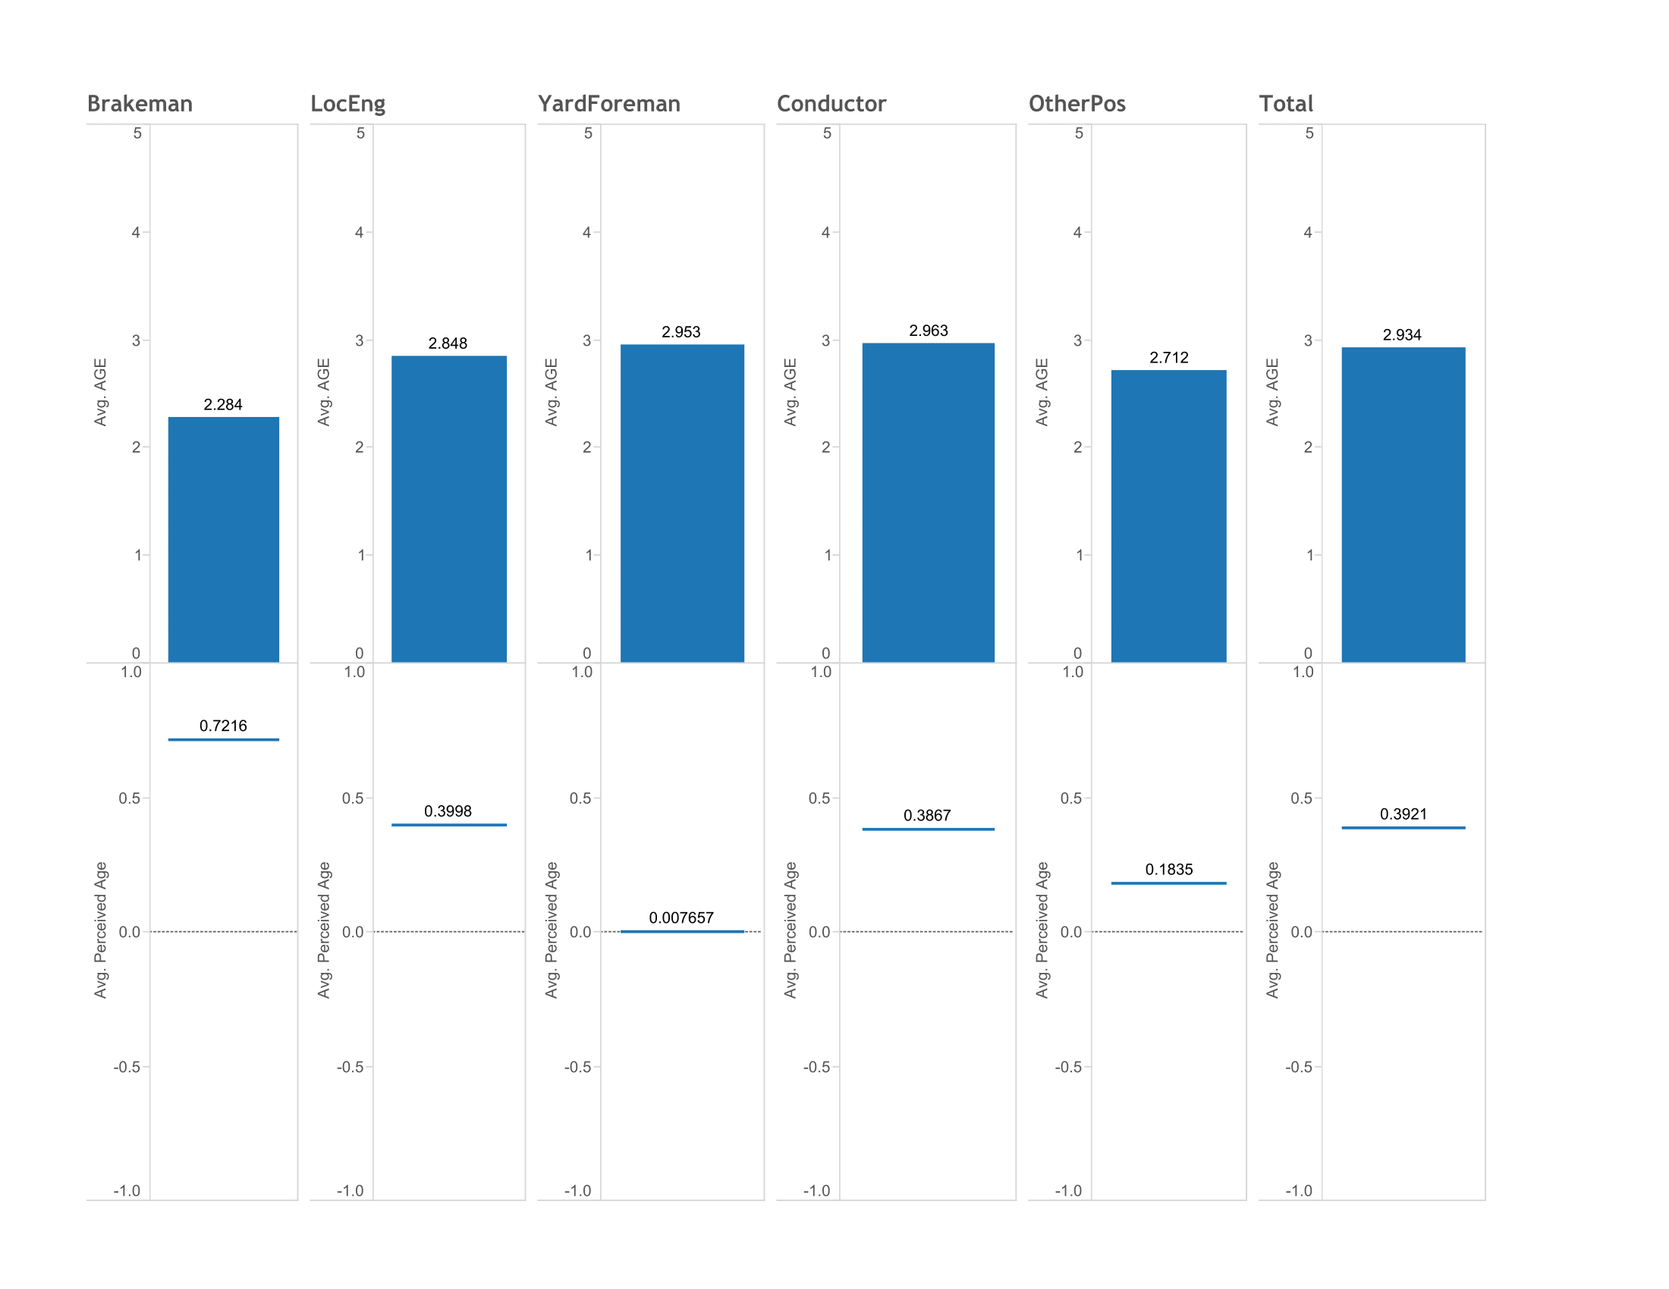
Job and Age Status
Jobs titles as dimensions
Separate worksheets
Utilized dashboard

